Slide 2
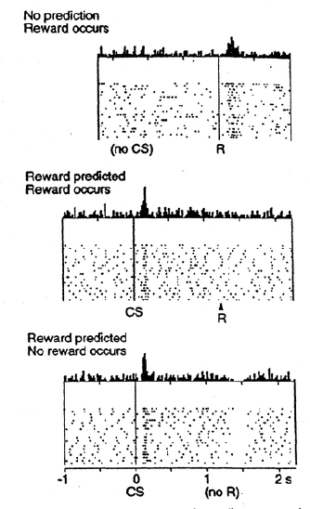
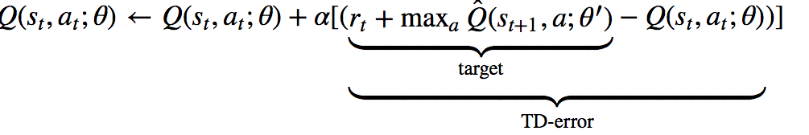
TD error and dopamine
The theory and data available today indicate that the phasic activity of midbrain dopamine neurons encodes a reward prediction error used to guide learning throughout the frontal cortex and the basal ganglia.

Slide 3
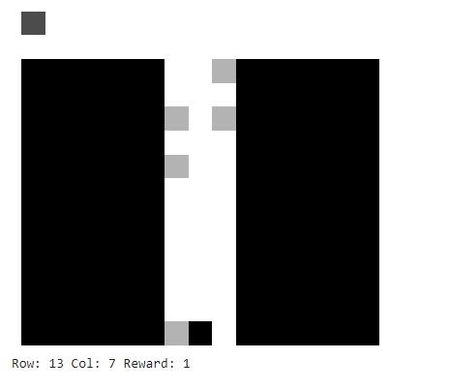
T-Maze Environment
Description: TMazeEnv1 simulates a T-shaped maze where a mouse agent navigates.
Maze: 15x15 grid with walls and open spaces.
Mouse Placement: Initial position specified as (mouse_row, mouse_col).
Cues: Randomly placed on left/right side. Number controlled by n_cues_left and n_cues_right.
Reward Rules: More cues on left: positive reward for left cues, negative for right cues (and vice versa).
Cue Visibility: Mouse detects cues below its position, receiving associated rewards.

Slide 4
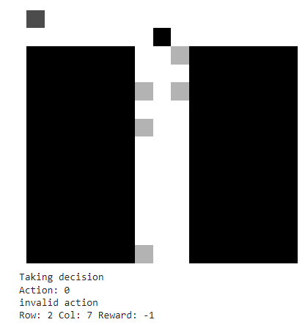
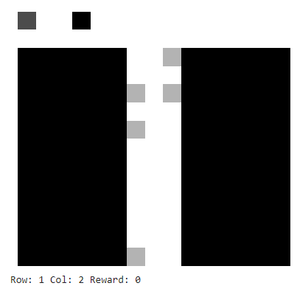
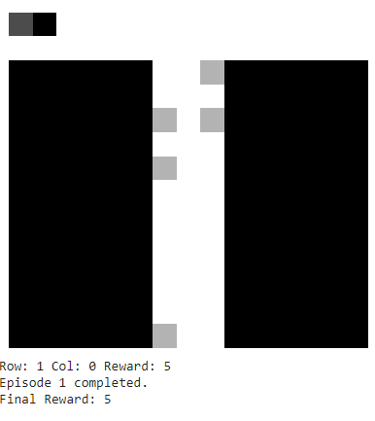
T-Maze Environment
Actions: Mouse can go straight (0), left (1), or right (2).
Goal: Reach leftmost cell in second row ((1, 0)) or rightmost cell in second row ((1, 14)).
Rewards: Mouse rewarded based on position, cues, and final locations.

Slide 5
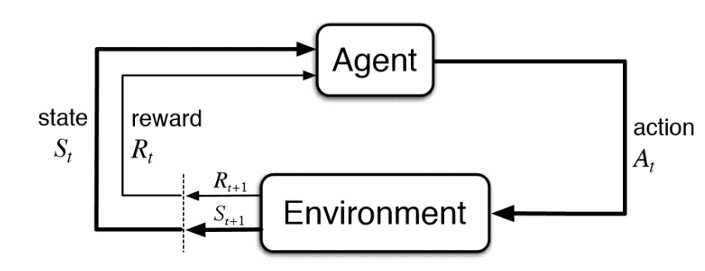
Overview of RL

Slide 6
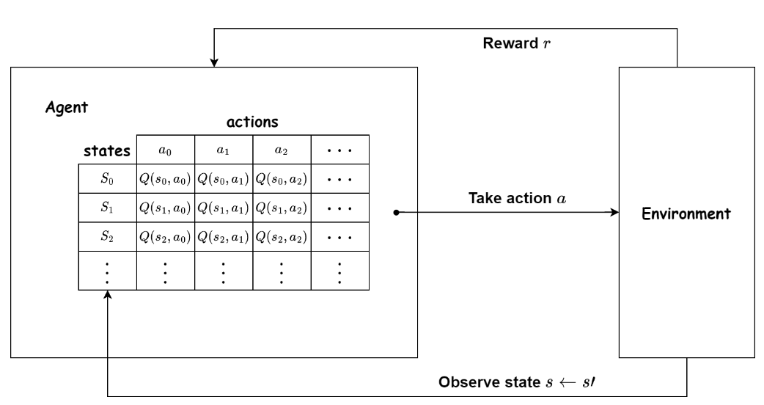
Q learning agent
Q-learning is a reinforcement learning algorithm used to find the optimal policy for decision-making in an environment.Steps involved
Initialize: Initialize the Q-values for all state-action pairs to arbitrary values.
Select Action: Choose an action to take based on the current state using an exploration-exploitation strategy (e.g., epsilon-greedy).
Take Action: Perform the chosen action in the environment and observe the next state and the reward.
Update Q-values: Update the Q-values based on the observed state, action, next state, and reward using the Bellman equation.
Repeat: Repeat steps 2-4 until the agent reaches a terminal state or a predefined number of iterations.
Deep Q-Learning is an extension of the Q-Learning algorithm that lBy using a deep neural network as a function approximator, Deep Q-Learning can learn a mapping between states and action values, enabling it to solve challenging reinforcement learning problems

Slide 7
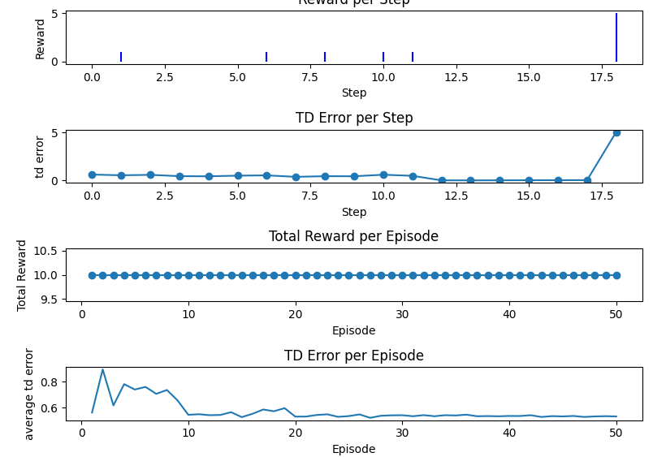
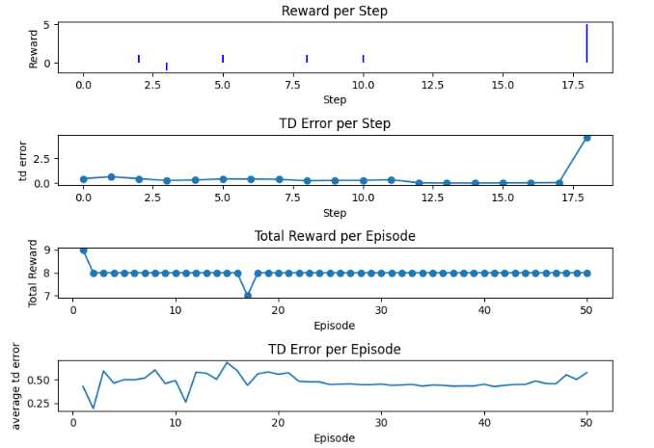
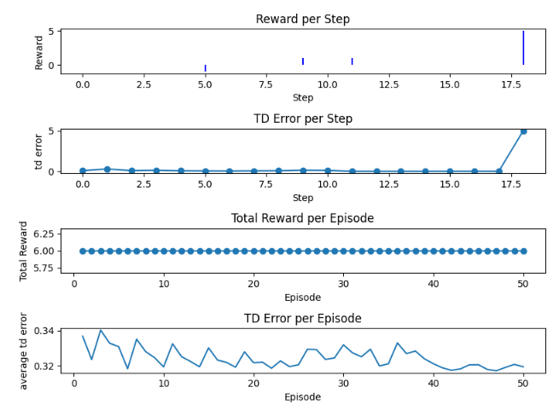
Encoding TD error in the simulated T-Maze Env
5 cues on the right
5 cues on right 4 on left
5 cues on right 2 on left

Slide 8
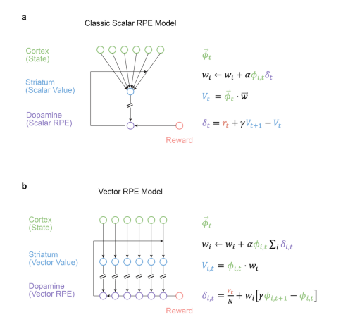
Vector RPE Hypothesis

Slide 9
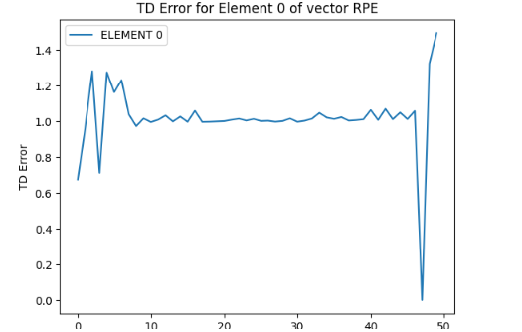
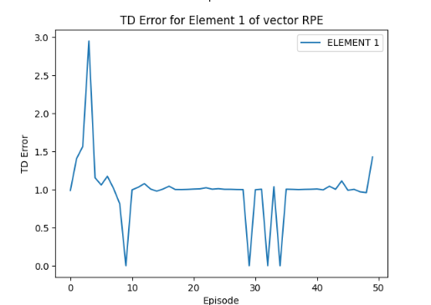
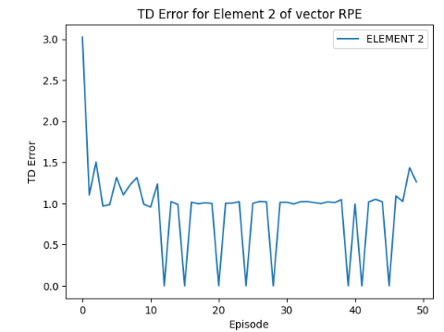
Vector TD error in the simulated T-Maze env
Vector RPE (Reward Prediction Error) encodes cues and rewards in an environment. Each element represents a cue, and the final element encodes the reward. The vector's dimensionality can be extended to include information like reward history
For the case where we have 5 cues n the right and zero on the left

